Slide 1





Day 1: Database Design Crash Course
Sean Wong
2025/08/04

Slide 2
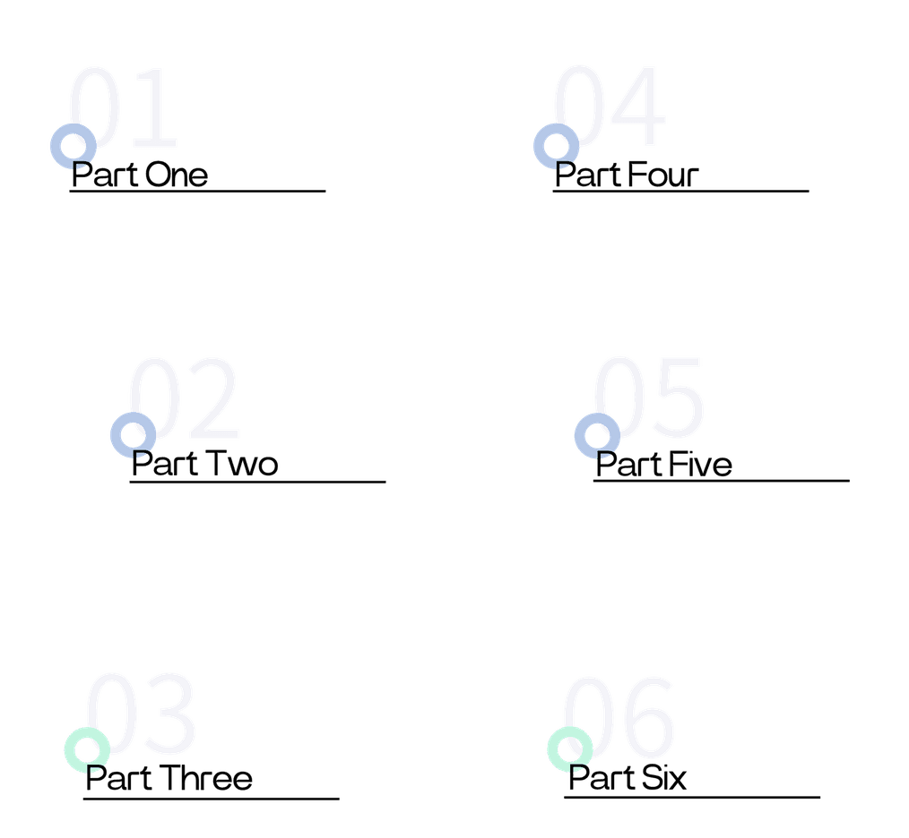

CONTENTS
Foundations of Databases
Data Modeling & ER Diagrams
Normalization Techniques
From Diagram to Schema
Design Best Practices
Wrap-Up & Next Steps

Slide 3

Foundations of Databases

Slide 4

What is a Database?
Purpose of Databases
The primary purpose of a database is to ensure data integrity, facilitate quick data retrieval, and support complex queries. It provides a reliable way to store data and ensures that it can be accessed and manipulated efficiently.
Definition of a Database
Types of Databases
A database is a structured collection of data stored electronically. It allows for efficient storage, retrieval, and management of information. Databases are essential for organizing data in a way that supports various applications and systems.
There are two main types of databases: relational and NoSQL. Relational databases, like MySQL and PostgreSQL, use tables to store data. NoSQL databases, such as MongoDB and Cassandra, offer more flexible data storage options.

Slide 5



Structure of Relational Databases
Relational databases store data in tables, which consist of rows (records) and columns (fields). Each table represents a specific entity, and relationships between tables are established through keys.
Key Concepts
Primary keys uniquely identify each row in a table. Foreign keys link tables together, ensuring referential integrity. These keys help maintain data consistency and integrity across the database.
Relational Database Essentials

Slide 6
Data Modeling & ER Diagrams

Slide 7



Definition of Data Modeling
Entities and Attributes
Data modeling is the process of defining the structure, relationships, and constraints of data. It helps in understanding how data is organized and how different entities interact with each other.
Entities are objects that hold data, such as customers or products. Attributes are properties or details about entities, like names or prices. These elements form the basic building blocks of a data model.
Relationships
Importance of Data Modeling
Concepts of Data Modeling
Relationships define how entities are connected. For example, a customer buys a product. These relationships are crucial for understanding the interactions between different data elements.
Effective data modeling ensures that the database design is logical and efficient. It helps in identifying redundant data and optimizing the database for performance and scalability.

Slide 8

ER Diagram Fundamentals
Components of ER Diagrams
ER diagrams visually represent data models using rectangles for entities, ovals for attributes, and diamonds for relationships. They also include cardinality notations to specify the multiplicity of relationships.

Slide 9



One-to-One (1:1)
One-to-Many (1:M)
Many-to-Many (M:N)
In a 1:1 relationship, a single record in one table is related to exactly one record in another table. This type of relationship is rare but useful in specific scenarios.
A 1:M relationship occurs when a single record in one table can relate to multiple records in another table. This is the most common type of relationship in relational databases.
M:N relationships involve multiple records in one table relating to multiple records in another table. These relationships require a junction table to be implemented in a relational database.
Cardinality Patterns

Slide 10
Normalization Techniques

Slide 11





Purpose of Normalization
Definition of Normalization
Benefits of Normalization
Normalization is the process of organizing data in a database to reduce redundancy and dependency. It ensures that each piece of data is stored only once, improving data integrity and consistency.
Normalization helps eliminate data anomalies, making the database more efficient and easier to maintain. It also ensures that updates, inserts, and deletions do not lead to inconsistent data.

Slide 12

Atomic Values
1NF requires that each column in a table contains atomic values, meaning that each cell should hold only one value. This ensures that data is stored in a structured manner.
First Normal Form Rules
Unique Rows
No Repeating Groups
Each row in a table must be unique, identified by a primary key. This ensures that there are no duplicate records, maintaining data integrity.
1NF eliminates repeating groups by splitting multi-valued entries into separate rows or tables. This prevents redundancy and ensures that each piece of data is stored only once.
Example
For example, a column for multiple phone numbers violates 1NF. Splitting it into individual phone number columns or rows resolves this issue, ensuring compliance with 1NF.

Slide 13






Second Normal Form Explained
2NF Requirements
2NF is achieved when all non-key attributes are fully functionally dependent on the entire composite primary key. This removes partial dependencies that can cause redundancy and update anomalies.

Slide 14

Third Normal Form Defined
Example
For example, the product price should not depend on the product category if the category is not part of the primary key. This ensures that updates to the category do not inadvertently affect the price.
3NF Definition
3NF removes transitive dependencies by ensuring that non-key attributes depend only on the primary key, not on other non-key columns. This prevents indirect relationships from causing data anomalies.
Benefits
3NF ensures that the database is free from update anomalies, making it more robust and easier to maintain. It also improves data consistency and reliability.

Slide 15
From Diagram to Schema

Slide 16

Converting Entities to Tables
Step-by-Step Conversion
To convert an ER diagram to a relational schema, map each entity to a table, transform attributes into columns, and represent relationships as foreign-key columns. This process ensures that the conceptual model is accurately implemented.
Importance of Accurate Conversion
Accurate conversion from ER diagrams to tables is crucial for maintaining the integrity of the data model. It ensures that relationships and constraints are correctly implemented in the database.

Slide 17

Writing CREATE TABLE SQL
Example
For example, to create a Customers table, you would use the following SQL: CREATE TABLE Customers (CustomerID INT PRIMARY KEY, CustomerName VARCHAR(255), ContactName VARCHAR(255), Country VARCHAR(100));
CREATE TABLE Syntax
The CREATE TABLE statement is used to create a new table in a relational database. It specifies the table name, column names, data types, and constraints.
Primary Key
The PRIMARY KEY constraint uniquely identifies each row in a table. It ensures that there are no duplicate records and that each row can be uniquely identified.
Data Types
Data types define the type of data that can be stored in a column. Common data types include INT for integers, VARCHAR for variable-length character strings, and DATE for dates.

Slide 18

Library Schema Walkthrough
Example Schema
In a library system, the Books and Authors entities are converted into tables. A foreign-key relationship is established between them to enforce the authorship relationship. This example demonstrates the practical application of ER diagram conversion.

Slide 19
Design Best Practices

Slide 20


Foreign Key
Foreign keys maintain referential integrity between tables. They ensure that relationships between tables are valid and that data remains consistent across the database.
Other Constraints
Primary Key
Other constraints like NOT NULL and UNIQUE ensure that fields have mandatory values and that all values in a column are distinct. These constraints help maintain data quality.
A primary key uniquely identifies each row in a table. It ensures that there are no duplicate records, maintaining data integrity and consistency.
Enforcing Integrity Constraints

Slide 21

Purpose of Indexing
Indexes optimize the retrieval of data by providing a faster lookup mechanism. They are particularly useful for columns frequently used in WHERE, JOIN, and ORDER BY clauses.
Balancing Indexes
While indexes improve query performance, they can slow down write operations. It is important to balance the number of indexes to ensure optimal performance for both read and write operations.
Indexing for Query Speed

Slide 22
Wrap-Up & Next Steps

Slide 23
02
03
Normalization
Schema Conversion
Normalize data to 1NF, 2NF, and 3NF to eliminate redundancy and ensure data consistency. This process helps in maintaining a robust and efficient database.
Translate ER diagrams into relational tables using SQL. Ensure that relationships and constraints are accurately implemented to maintain data integrity.
04
01
Best Practices
Data Modeling
Enforce integrity constraints and use indexing to optimize performance. These practices ensure that the database is reliable, efficient, and easy to maintain.
Model data using entities, attributes, and relationships. This foundational step ensures that the database structure is logical and well-organized.
Key Takeaways Review

Slide 24

Preview of Day 2 Topics
Upcoming Topics
On Day 2, we will cover advanced normalization techniques (4NF and 5NF), NoSQL design principles, SQL query optimization, and a hands-on project to apply all learned skills in a real-world scenario.

Slide 25



Sean Wong
2025/08/04

